Slide 1
SOFTWARE ENGINEERING
MINI PROJECT

Slide 2
PRISON MANAGEMENT SYSTEM

Slide 3
TEAM MEMBERS
GOKULRAJAN T
RAMASAMY PL
AANANDHAMURUGAN P
AJMEER RAJA M
AJITHKUMAR A

Slide 4
1.OBJECTIVE
To maintain the details of the accused and the officers in charge.
To promote more security by using better schedule.
For a developing nation effective technologies required in all fields. Thus we have decided to involve our technical skills in this field.

Slide 5
2.Purpose of study
To improve the productivity and efficiency of the prison so as to facilitate the usage of the available work force for sensitive work while leveraging technology to reduce the mundane workload of the employees.
To ensure the availability of data in digital from for preservation, analysis and reporting.
To address the problem of congestion, denial of bail jailbreaks etc. by providing an efficient documentation technique.
To ensure proper monitoring of the prisons by the top officials.

Slide 6
3.Scope of the study
Criminal general particulars.
Particular of crime and conviction of prisoners.
Transfer of prisoners.
Remand warrant.
Discharge of prisoners.

Slide 7
4.Specific Requirements

Slide 8
4.1 Functional Requirements
Log-in/Log-off (Admin and officers)
Search Criminals/Prisoners (to find the particular details of the criminals).
View criminal report (that consist of the categorized details of criminals)
Bail and parole reports
Registration for criminals (Add criminal)
Visitor details
Penalty and salary
Work time

Slide 9
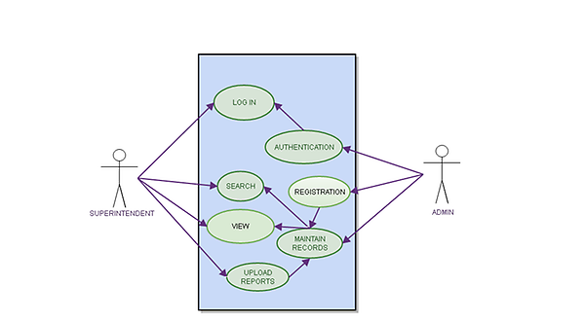
4.1.1 Use case Diagram

Slide 10
4.2.2.1 Use Case Description – Login

Slide 11
4.2.2.4 Use Case Description – Registration

Slide 12
4.2.2.2 Use Case Description – Authentication

Slide 13
4.2.2.3 Use Case Description – View

Slide 14
4.2.2.5 Use Case Description – Bail and parole

Slide 15
4.2.2.5 Use Case Description – Penalty, salary

Slide 16
4.2 Non-functional Requirements
Performance
Security
Maintenance
Reliability
User Interface
Documentation

Slide 17
Conclusion

